Slide 1
Strengthening Community Research in Remote Service Delivery at Ntaria and Yuendumu
<Australasian Evaluation Society 2011 International Conference, Sydney September 2011_presentation
Notes:
Hello, my name is Judy Lovell and I am a Senior Researcher with Ninti One based in Alice Springs. Ninti One manages the Cooperative Research Centre for Remote Economic Participation (CRC-REP), the Business Development Unit (BDU) and the Business Realisation Unit.
Within this structure the Business Development Unit employs community research teams and implements the FaHCSIA initiative we are going to tell you about today, called Strengthening Community Research in Remote Service Delivery in Ntaria and Yuendumu.

Slide 2
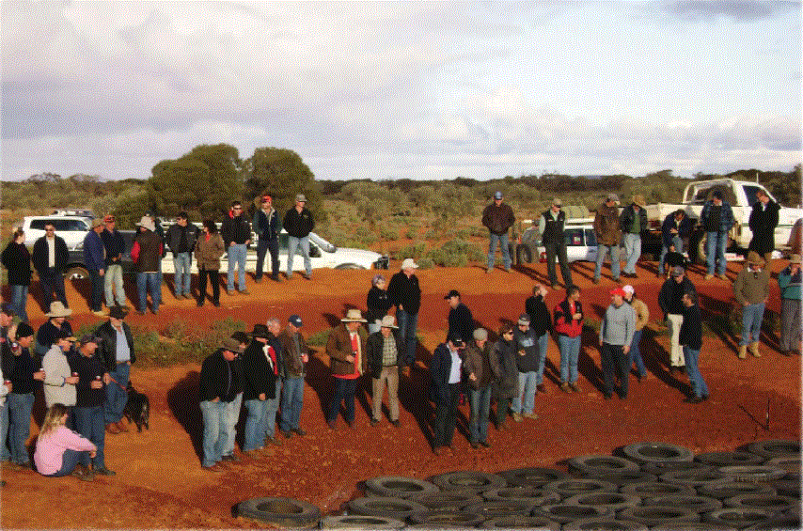
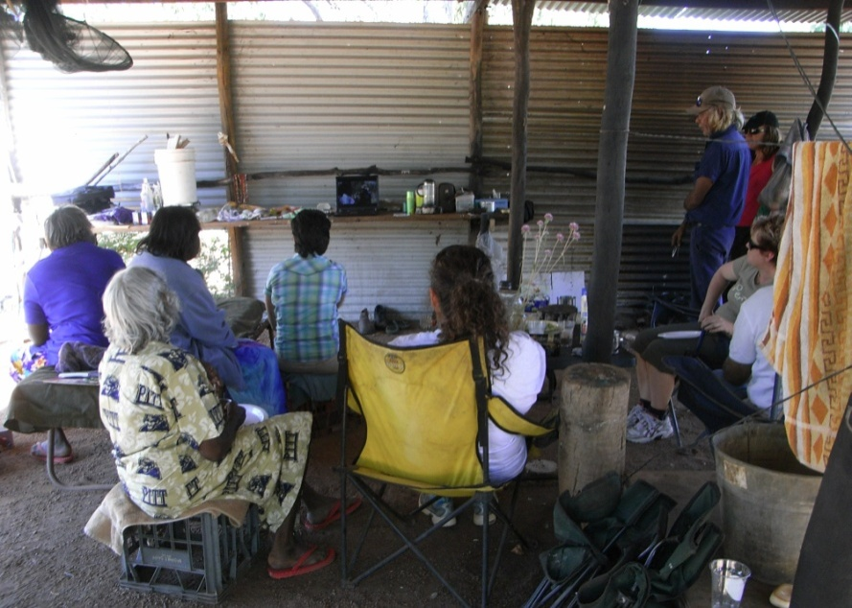
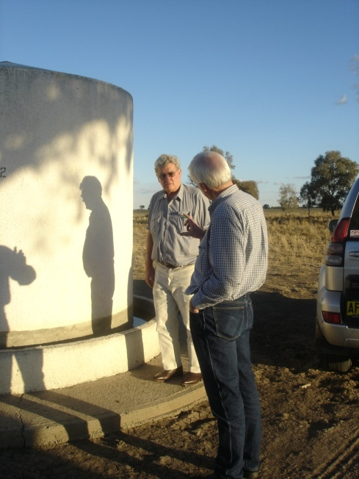
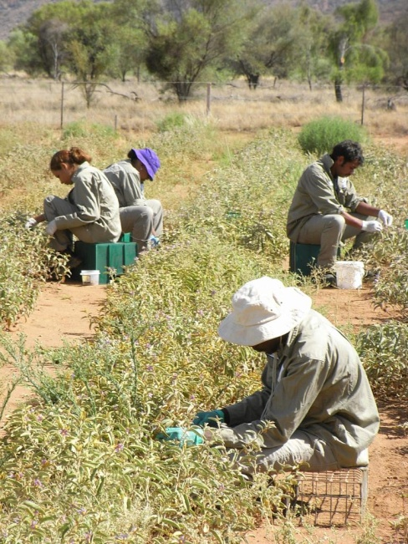
Above: Water Smart field workshop, Below: Pastoralists’
Water Smart field demonstration
Above: Bush Tomato harvest onsite planning
For more about our work visit:
www.nintione.com.au
www.crc-rep.com.au
Or contact Mark Ashley
Managing Director, BDU
M: 0488 155 063
Above: Bush tomatoes
harvesting by hand.
Notes:
This project builds on work previously undertaken by Ninti One in remote Australia for partners in the Pastoral and Mining industries, and Aboriginal and Torres Strait Islander communities. You can find out more about us on the web-sites, but a few examples of recent work are:
Improving the participatory evaluation of the Indigenous Pastoral Program (IPP) and the Kimberly Indigenous Management Support Service (KIMSS) programs: engaging Aboriginal community members as evaluators. 2008
The Water Handbook, A guide for management of small water supplies in Australian Aboriginal settlements, 2008
Desert Services that Work: Demand-responsive approaches to desert settlements. DKCRC Research Report 70. Ninti One Limited, Alice Springs.
The Minerals Council of Australia and Australian Government Memorandum of Understanding on Indigenous Employment and Enterprise Facilitation: Evaluation of the initial roll-out phase,
Aboriginal Knowledge and Intellectual Property Protocol Community Guide, 2009. Ali Curung Shared Responsibility Agreement Evaluation:

Slide 3
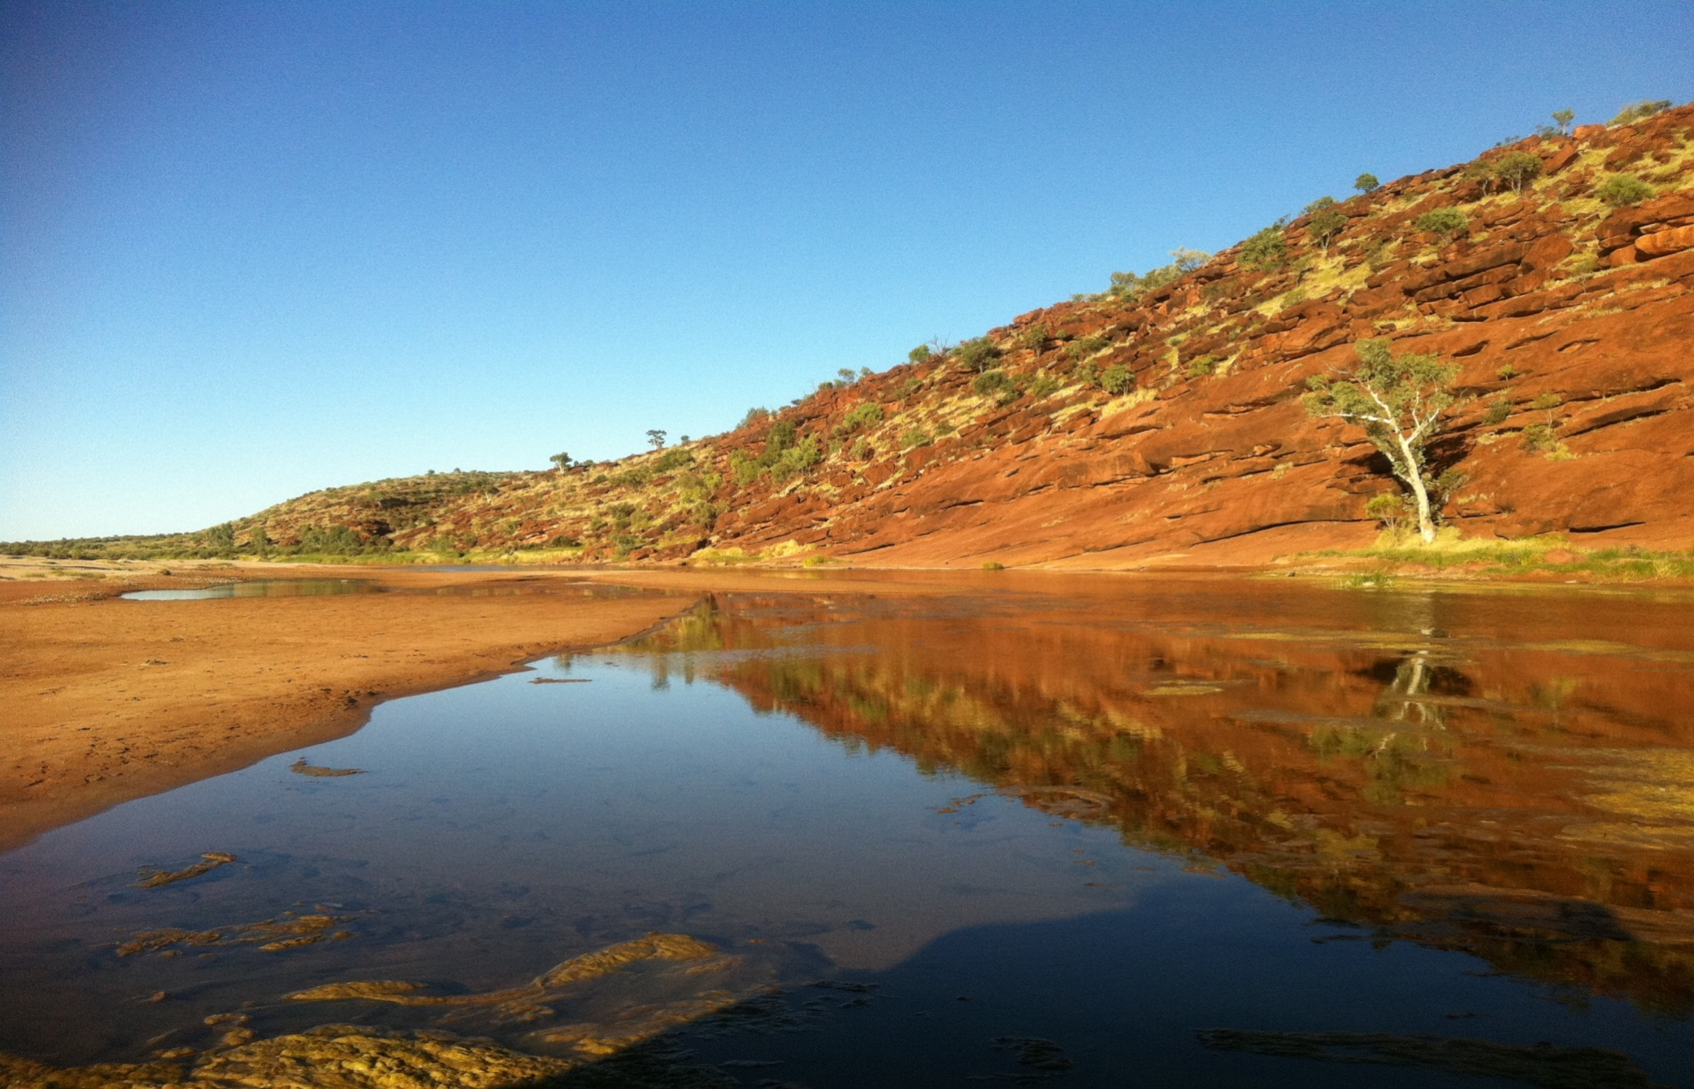
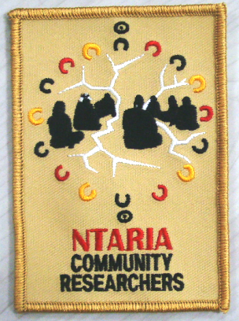
When it’s the right time, rain comes, and lightning brings a new start.
Edward Rontji, 2011.
IEO and project cultural mentor at Ntaria
Ntaria Community Researchers’ logo was designed by the Ninti One Ntaria. research team
3
Notes:
Currently Ninti One employs remote community researchers under the terms of the FaHCSIA initiative Strengthening Community Research in Remote Service Delivery at Ntaria and Yuendumu.
Ntaria has a team of ten and at Yuendumu, three Community Researchers. These two projects will run for 18 months at each site. A primary objective of the project is to develop teams who conduct participatory action research (PAR) and deliver their research findings back to the Local Reference Groups, or other community representatives.

Slide 4
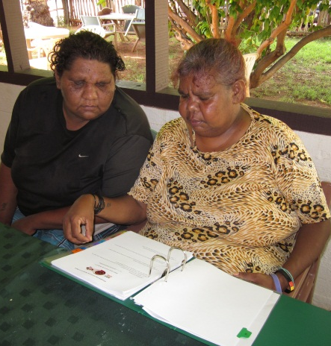
Top l-r: Mark Inkamala, Mike Lawson, Edward Rontji, Anna-Marie Armstrong, Merissa Emitja, Elsie Patrick, Judith Henderson and Ada Lechleitner prepare report for Wurla Nyinta.
Bottom; Roslyn Raberaberra and Anna-Marie Armstrong reviewing protocols for translation.
Notes:
The community research team leaders at Ntaria are Ada Lechleitner and Mark Inkamala, who have been involved in this research since start-up in January 2011. Edward Rontji, the Indigenous Engagement Officer at Ntaria, acts as the cultural mentor for the Ntaria project, and provides feedback to the research team and to Wurla Nyinta, the Ntaria Local Reference Group, about the direction and findings of the research.

Slide 5
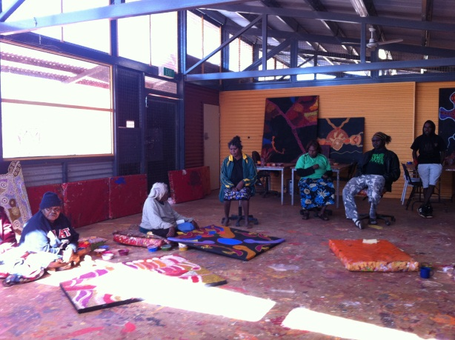
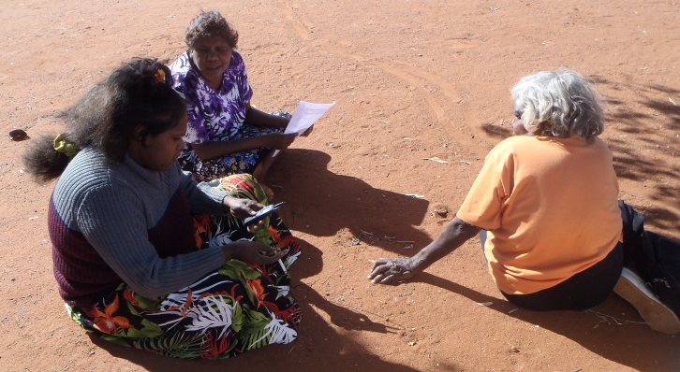
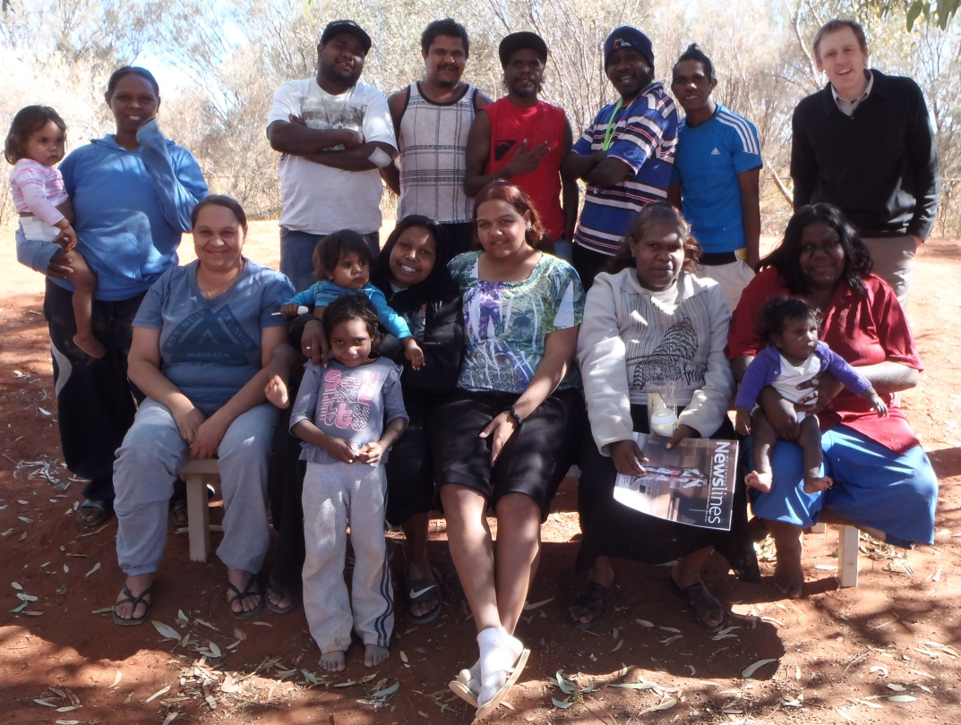
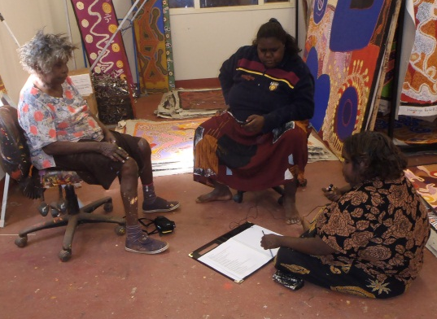
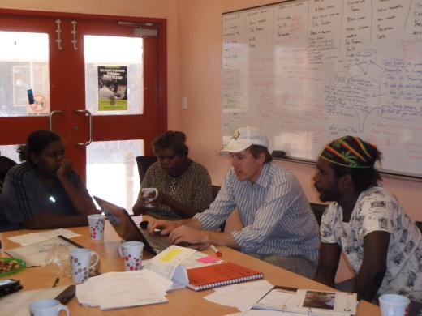
Top r-l: Deborah Burton, Samara Burton Stewart Gaykamangu talk with Tjala Artists;
Bottom r-l: Tjanangu Riley and Serena Ken interview senior artist Iluwanti Ken; Top middle: Samara and Deborah Burton interview senior artist Paniny Mick
Top r-l: Jacob Tiger, Nigel Mervin, Ngunytjima Lewis and Stewart Gaykamangu tally survey data;
Bottom r-l: writing survey questions, Stewart Gaykamangu, Sam Osborne, Deborah Burton, Serena Ken
(Front left) Lorraine King, Julianne Campbell, Nicole Kunoth-Hampton, Samara Burton, Serena Ken. (Back left) Sabrina Campbell, Atu Campbell, Nigel Mervin, Ngunytjima Lewis, Stewart Gaykamangu, Jacob Tiger, Sam Osborne
Amata and Mimili Community Research teams:
5
Notes:
Between April and July 2011 Ninti One completed projects with Anangu from the communities of Amata and Mimili in South Australia. Sam Osborne and Lorraine King provided project leadership in the communities where researchers chose to focus on how families look after old people in Mimili; Bush medicine the benefits and the risks: economic, social and health in Amata, and the stories beneath the canvas at Tjala Arts in Amata.

Slide 6
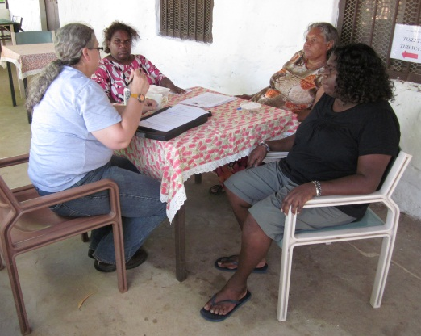
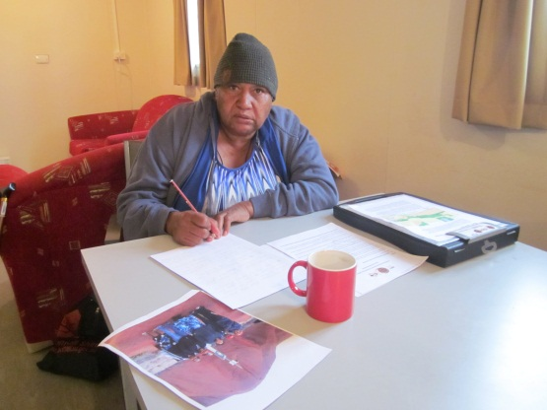
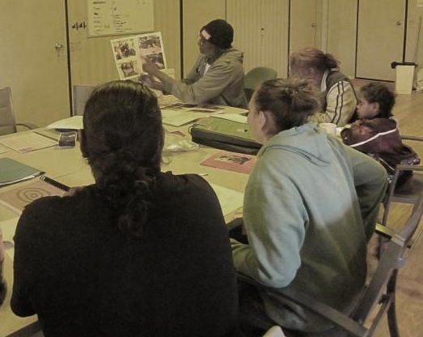
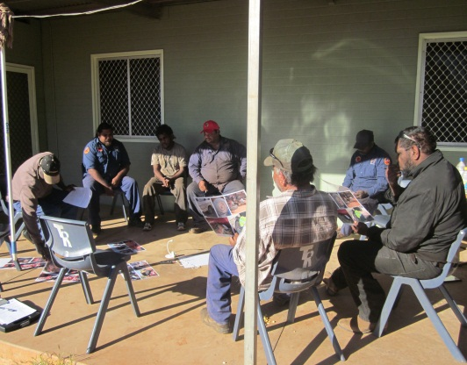
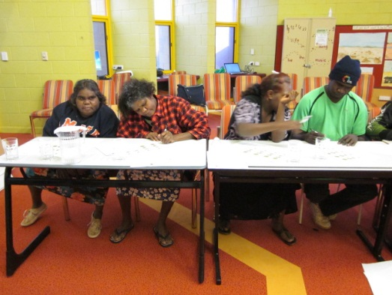
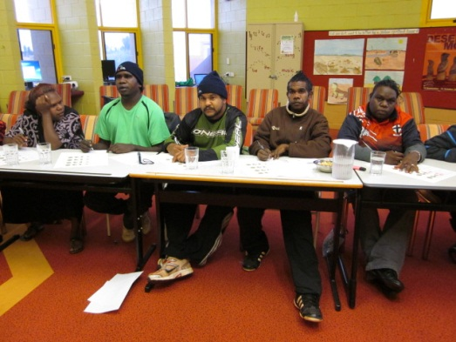
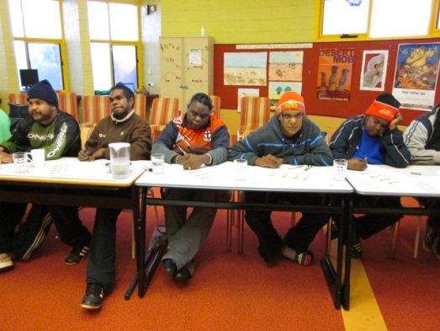
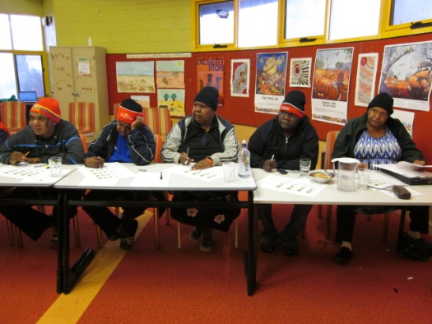
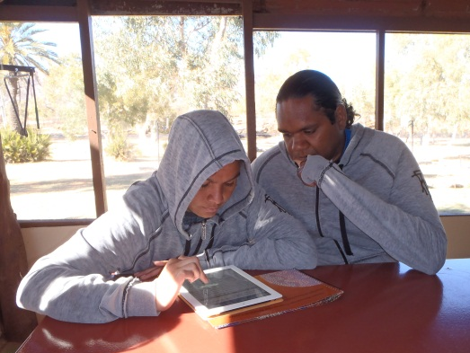
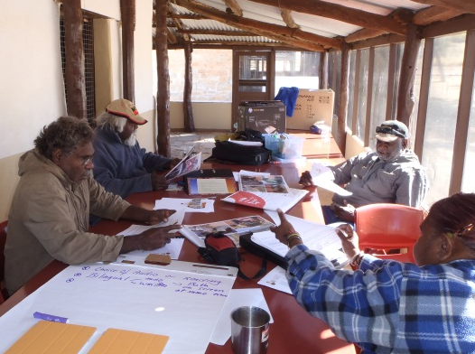
Above: Ntaria Community Researchers at work
Above: Combined Community Researchers training at Yulara
Above: Combined Community Researchers training at Hamilton Downs
Notes:
Another primary objective of the project is developing good research and evaluation skills so that the teams become confident and capable of working in a range of research settings using various methods.
We learn-on-the-job in combination with focused workshops that bring everyone together for training about participatory action cycle and the teams use their knowledge, skills and competencies in analysis and evaluation of the research findings, and reporting.
The project scope to apply Participatory Action Research to aspects of the Local Implementation Plan is very wide. At Ntaria the team collected and reviewed background information from FaHCSIA and Remote Operational Centre (ROC) staff, the Community profiles from baseline mapping, and advice from service delivery agencies about priorities and issues.
Several topics were then explored until the team decided to undertake a Safe Driving survey of Ntaria residents first. Safe Driving is an issue that impacts on many families, and it is a Community Led Action in the Ntaria LIP.

Slide 7
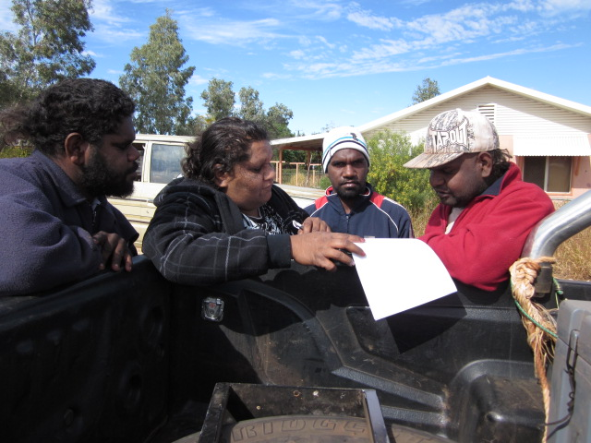
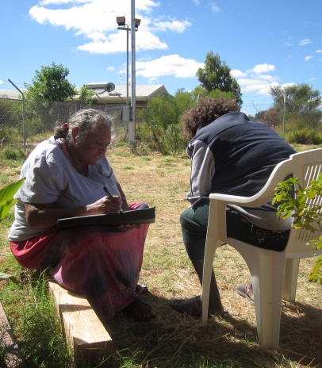
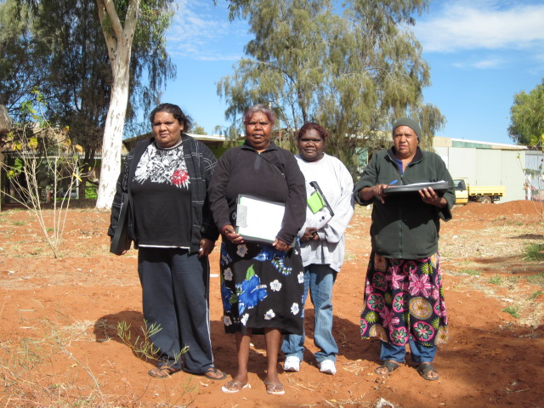
Notes:
Hello my name is Ada Lechleitner and I was born at Ntaria. I do this work because I am most concerned about family members that are branded by having no licence for driving and other charges that stay on their record for all the rest of their life. By doing this research in our own language, then people really talk, and that’s how they change.
Participatory Action Research (PAR) is a method where community researchers participate in all parts of the research. It shows how we work as local researchers; how we can bring our skills into community research.
The Safe Driving survey findings were presented in Western Arrarnta to Wurla Nyinta. Speaking now about Ntaria Community Research we can say that the researchers have brought high quality research findings to Wurla Nyinta, the Local Reference Group, to assist in community decision making.

Slide 8
Question from Safe Driving Survey, Action Cycle One, May 2011.
How safe is the car you drive ?
Sometimes = 32%
If you need, you drive un-roadworthy or unregistered = 68%
Compiled from local police records at Ntaria, August 2011
Charges relating to driving in the land trust: July 2010 to June 2011
Traffic offences = 72%
Notes:
The community people who do the surveys and focus groups with us are able to be part of the decision-making because we take their opinions forward through our research reports. Without this research that wouldn’t be happening and Wurla Nyinta might not hear so much from the community.
We have done the first cycle of research about the LIP Community Action on Safe Driving. We wrote a survey and surveyed 20% of the drivers in all those age groups in the community who are over 18 years and under 65 years old.
The results led us to design a second cycle of research about Safe Driving through using a focus group and photographs we’ve taken about vehicle maintenance and safety in Ntaria.

Slide 9
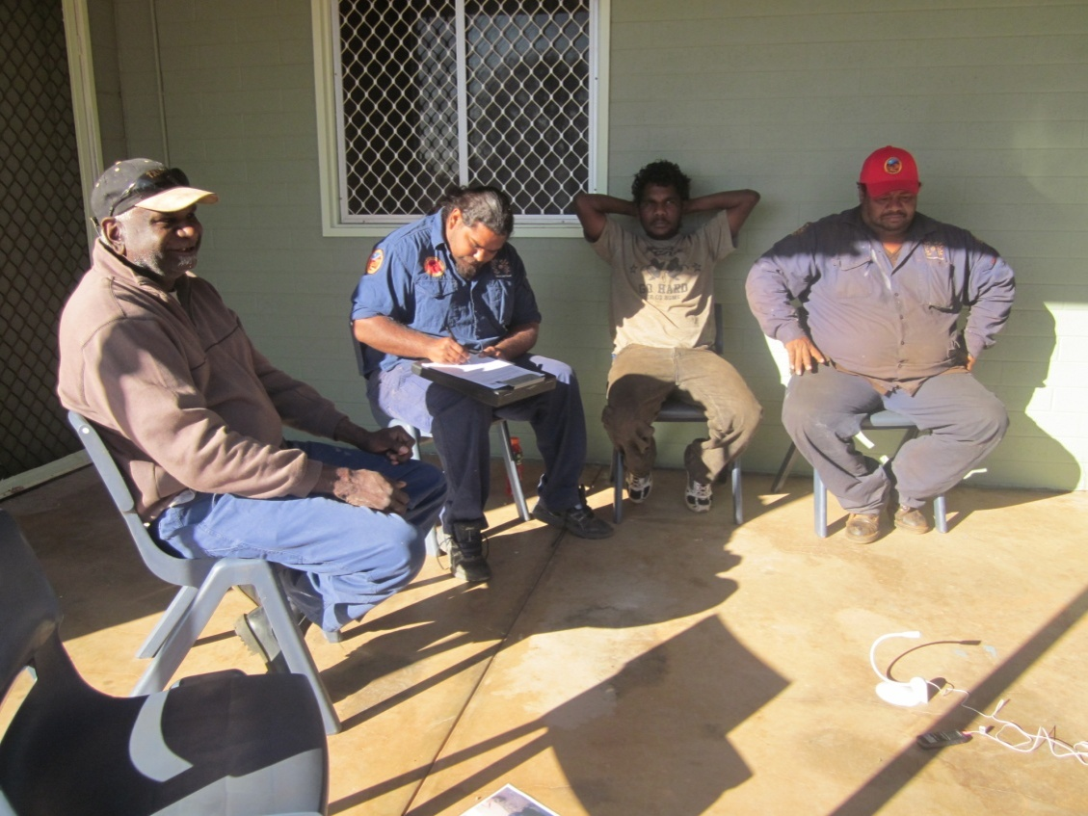
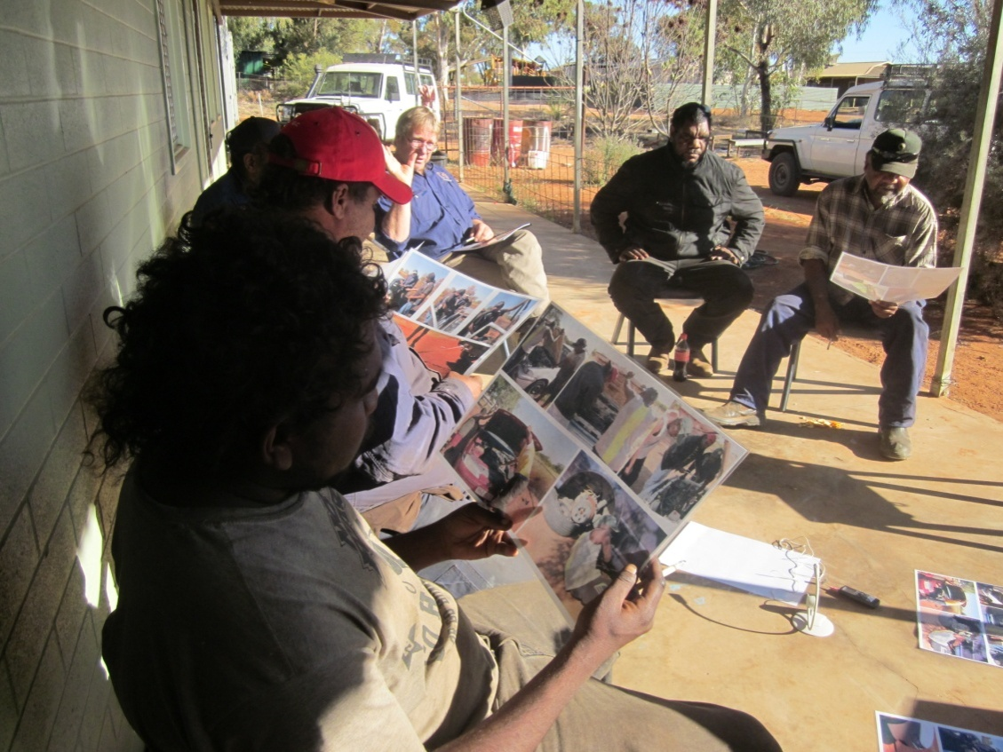
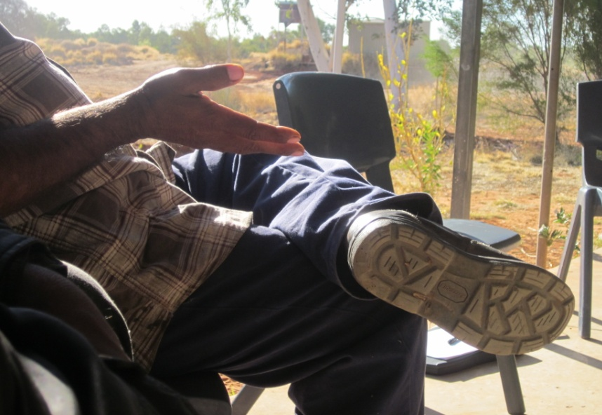
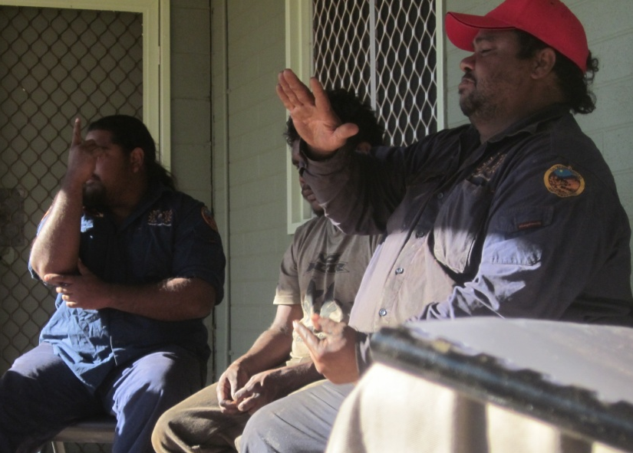
Notes:
Hello my name is Mark Inkamala, I think this work is really important because community researchers can really talk and speak to others at Ntaria in language and people trust us to listen to what they really mean. Then we can take this to Wurla Nyinta and to FaHCSIA and tell them how things can change in our community.
When I run the focus groups or talk to community about research I speak Western Arrarnta because it’s the easiest way to get through to people. I get better stories and information because people open themselves easily to talk about the questions I ask. They feel comfortable.
We work outside when we can, in a circle.
In this focus group I use photos that the research team took. We did that because the photos get people thinking and talking about the same thing – looking at the same thing together.
This group are Tuwunpa Rangers, and you can see they work together as younger and older men in a group.
In the focus group we are thinking and talking about safety, about the dangers they have experienced and about ideas for the community as ways to improve things around safe driving. The main ideas so far are:
To have a mechanic and workshop on the community, and make it accessible for people living there to learn and to do better maintenance on their own cars.
To get better driver training for young people, both young women, girls, young men, boys.
To have licence training and road rules and safety taught in Arranta as well as English, for people to learn safety in their own language and understand that way first.
These are ideas we take to Wurla Nyinta – our local reference group. They are telling us to keep going with the research, and develop these ideas up more. We always take our research back to them for comment and feedback.

Slide 10
The board of Ninti One supports the aim of building research capacity in remote communities across the breadth of the organisation including in major research projects undertaken through the Cooperative Research Centre for Remote Economic Participation (CRC-REP).
Ninti One recognises that the goal of sustainable, healthy and viable remote communities is intrinsically linked with the participation, ownership and partnership of the residents of those remote communities, and their capacity to engage in meaningful economic activity.
Ninti One supports development of remote community research hubs where multi-lingual community members undertake high quality research; and the research is of direct benefit to those communities, and may be made available to an inter-cultural audience
Notes:
Remote Community Researchers actively develop the process of community representation in governance and decision-making by engaging in research that reports back to the Local Reference Groups or other community governance boards or organisations. Presently, there is no structure in place to resource, support or facilitate activities and decision making processes of the Local Reference Groups in Remote Service Delivery sites.
In the longer term, establishing sustainable remote research hubs will maximise the contribution of specialist Aboriginal and Torres Strait Islander knowledges that include multiple literacies, languages, cultural protocols, inter-cultural processes, the community’s ‘corporate’ knowledge, and daily lived experiences. The wider impacts will include positive benefits to health, education, economic development, and increased participation in cultural maintenance and transmission. These are all recognised as significant targets in the Overarching Bilateral Indigenous Plan between the Commonwealth of Australia and the Northern Territory of Australia To Close the Gap in Indigenous Disadvantage 2010 – 2015.

